Slide 1



MINI-PROJECT PRESENTATION
Academic Year (2024-25)
(IV Semester)
Course Code:22CD49
“GYM MANAGEMENT SYSTEM”
Presented By:
Kshitij Singh -
Pranav B -
Shodhan S -
Tejpal Aradhya CP -
1DS23CD026
1DS23CD036
1DS23CD050
1DS23CD057
Under The Guidance Of
Ms.Bhagyashree
Professor
Dept. of CSE(Data Science)
DSCE, Bangalore
Department of CSE (Data Science), DSCE

Slide 2

CONTENTS
Abstract
Introduction
Problem Statement
Literature Survey
Architecture of the project
Algorithm of the Project
Project Flow
Motivation of the Project
Objective and Scope of the Project
Software & Hardware Requirement
References

Slide 3
ABSTRACT
A web-based Gym Management System developed using html,css ,js , Python Flask and Oracle Database (backend) that automates member registrations, workout scheduling, payment processing, and equipment tracking. The system implements proper database normalization (3NF), stored procedures, and transactions for data integrity.
Department of CSE (Data Science), DSCE

Slide 4
INTRODUCTION
What is the system?
Digital solution for gym operations
Replaces manual record-keeping
Key Features
Member portal (registration/login)
Trainer-session scheduling
Payment tracking
Equipment maintenance logs
Tech Stack
Frontend: HTML/CSS/JS,
Backend: Oracle XE 21c, Flask
Tools: SQL Developer, VS Code
Department of CSE (Data Science), DSCE

Slide 5
PROBLEM STATEMENT
Current Challenges
Manual member record maintenance
No centralized workout tracking
Payment disputes due to poor records
Difficulty managing equipment
Solution Benefits
90% faster member onboarding
Real-time session availability
Automated payment receipts
Maintenance alerts for equipment
Department of CSE (Data Science), DSCE

Slide 6
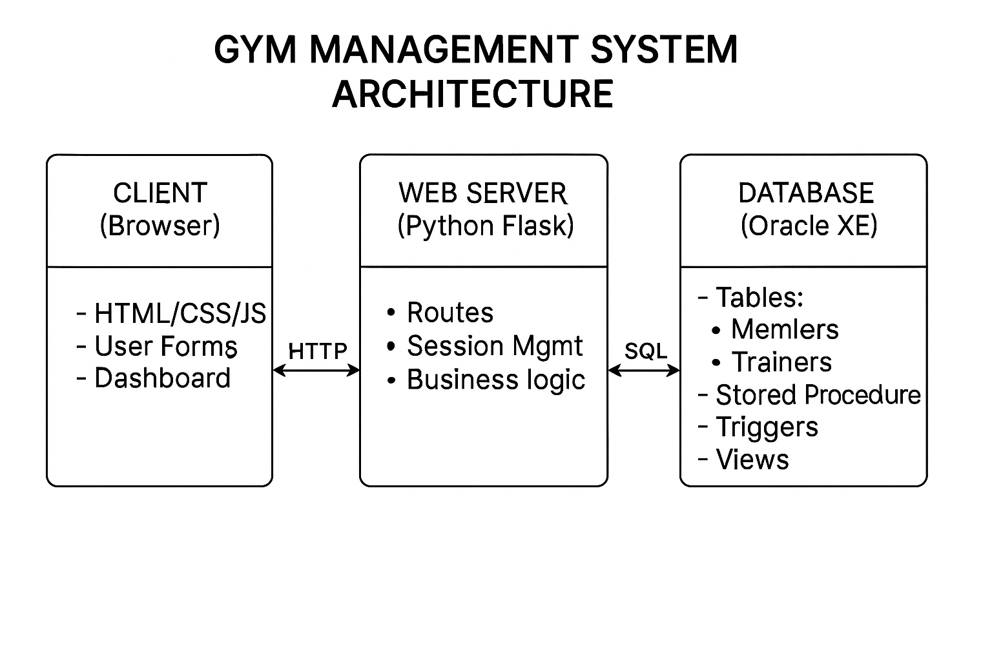
ARCHITECTURE OF THE PROJECT
Presentation Layer
Flask templates (HTML/CSS/JS)
Application Layer
Python Flask routes
cx_Oracle connector
Database Layer
Oracle XE 21c
Tables: Members, Trainers,
Payments, etc.
3 Stored Procedures
3 Triggers

Slide 7
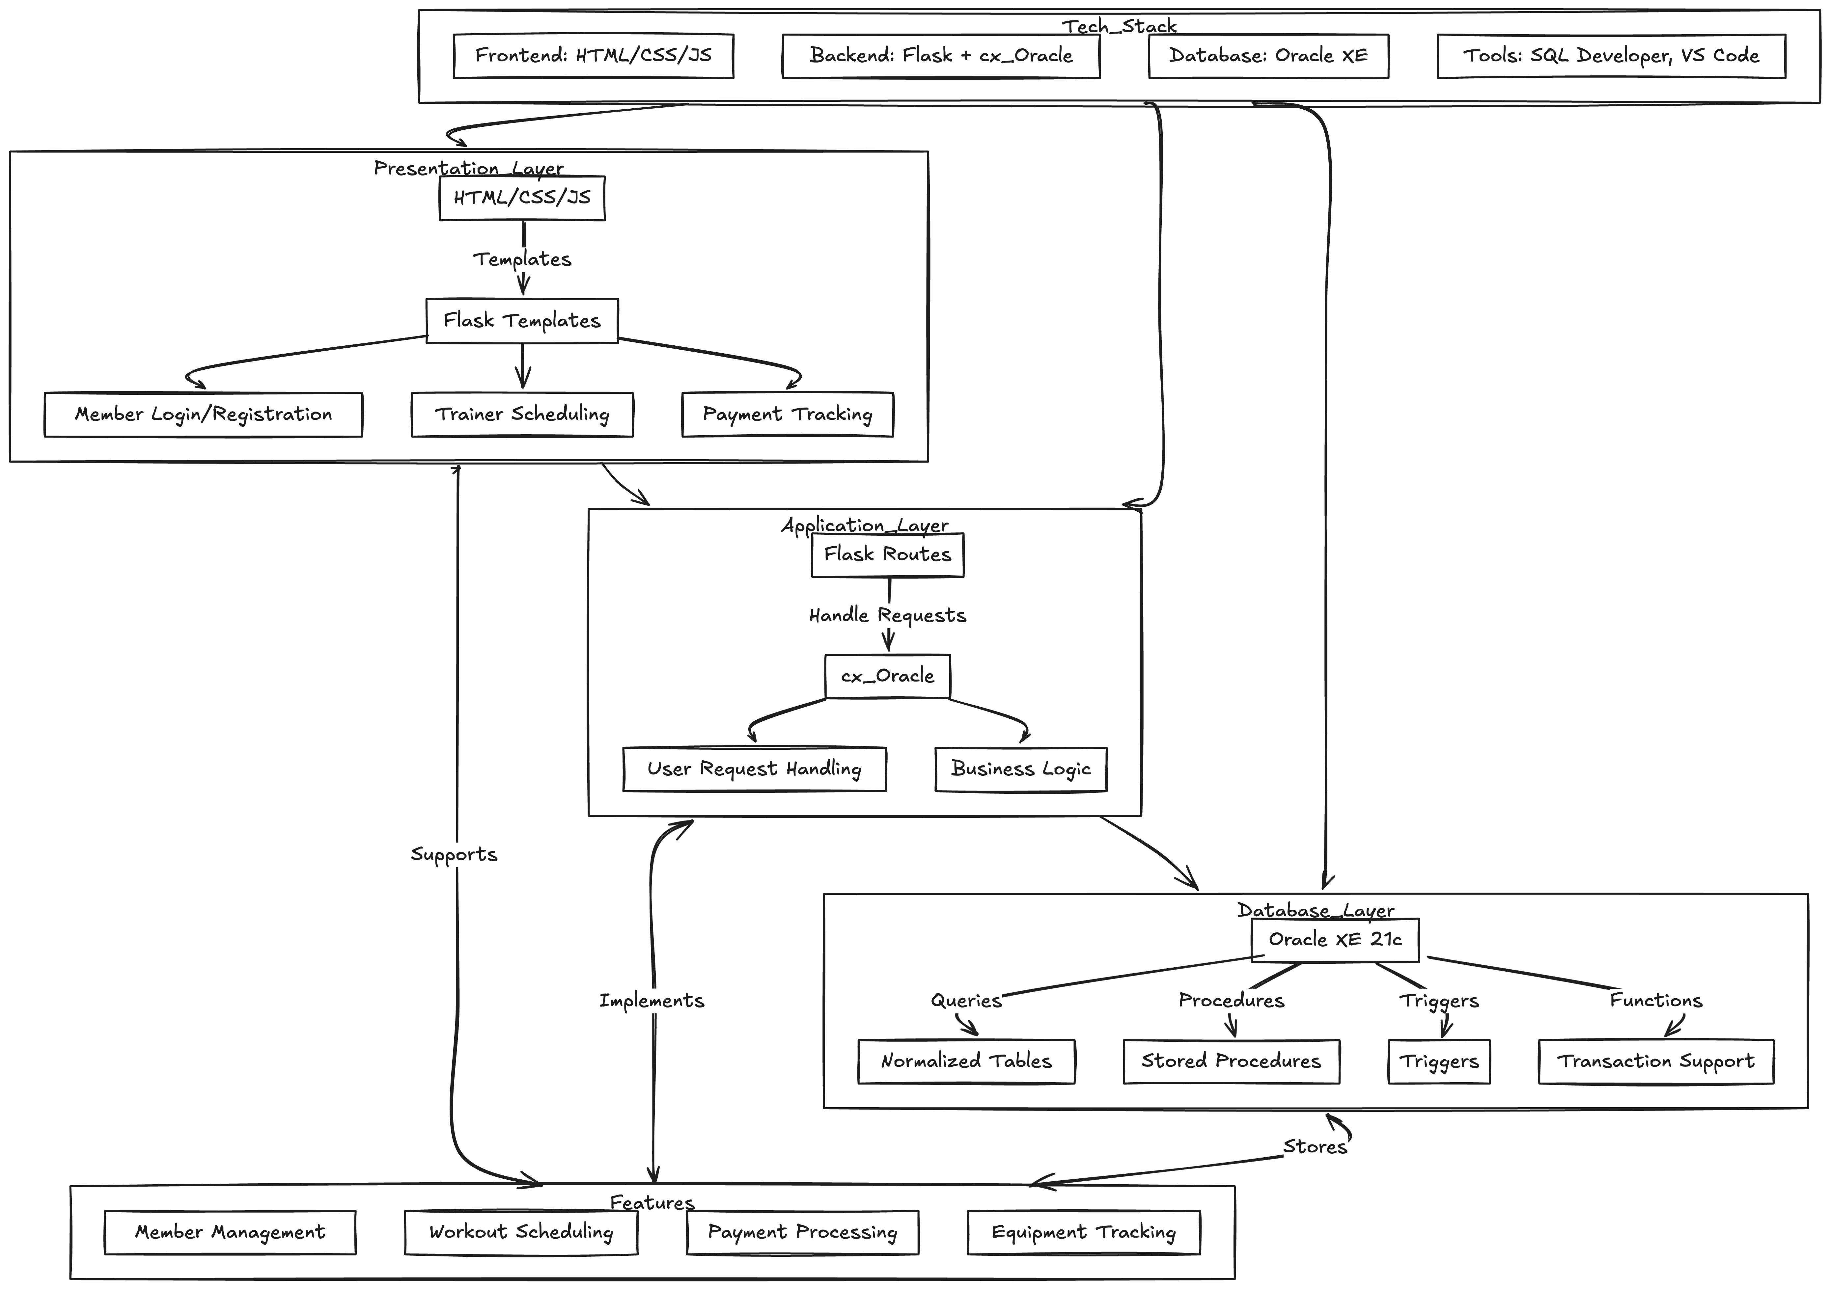
ARCHITECTURE OF THE PROJECT

Slide 8
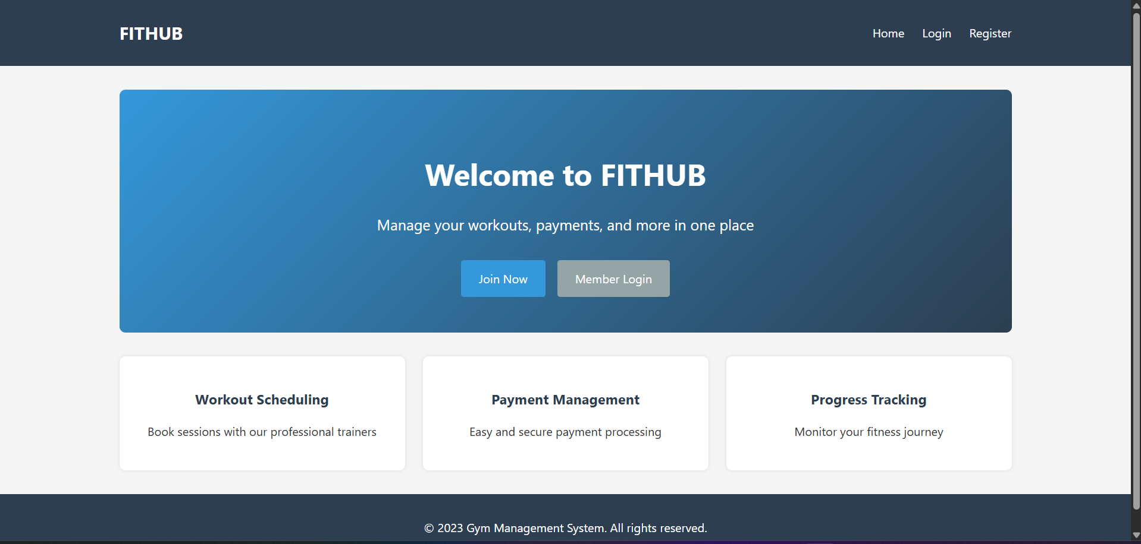
ARCHITECTURE OF THE PROJECT
HOME PAGE

Slide 9
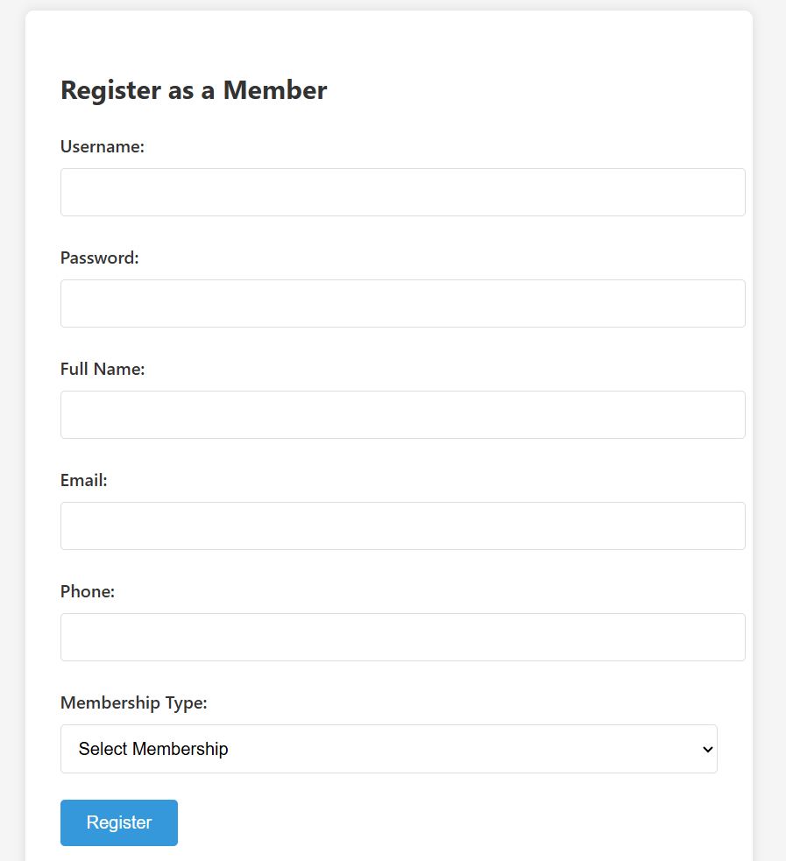
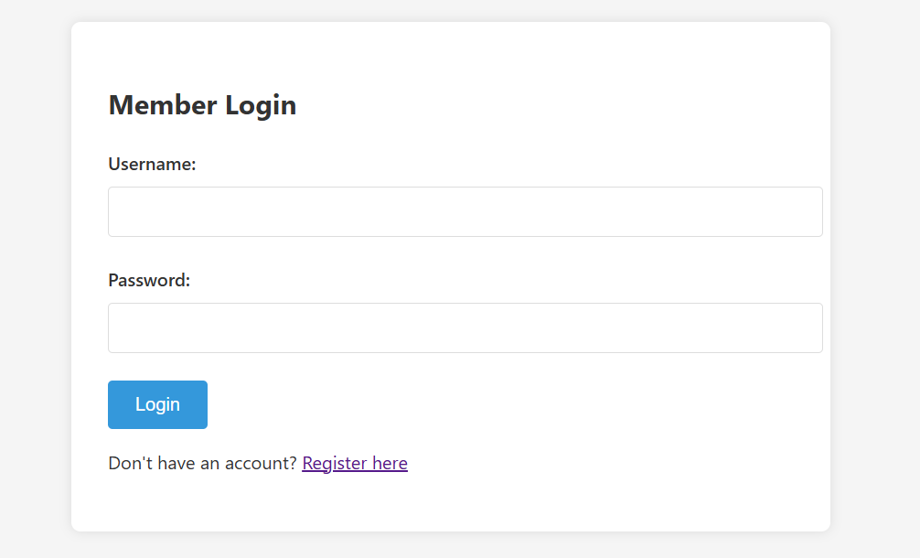
ARCHITECTURE OF THE PROJECT

Slide 10
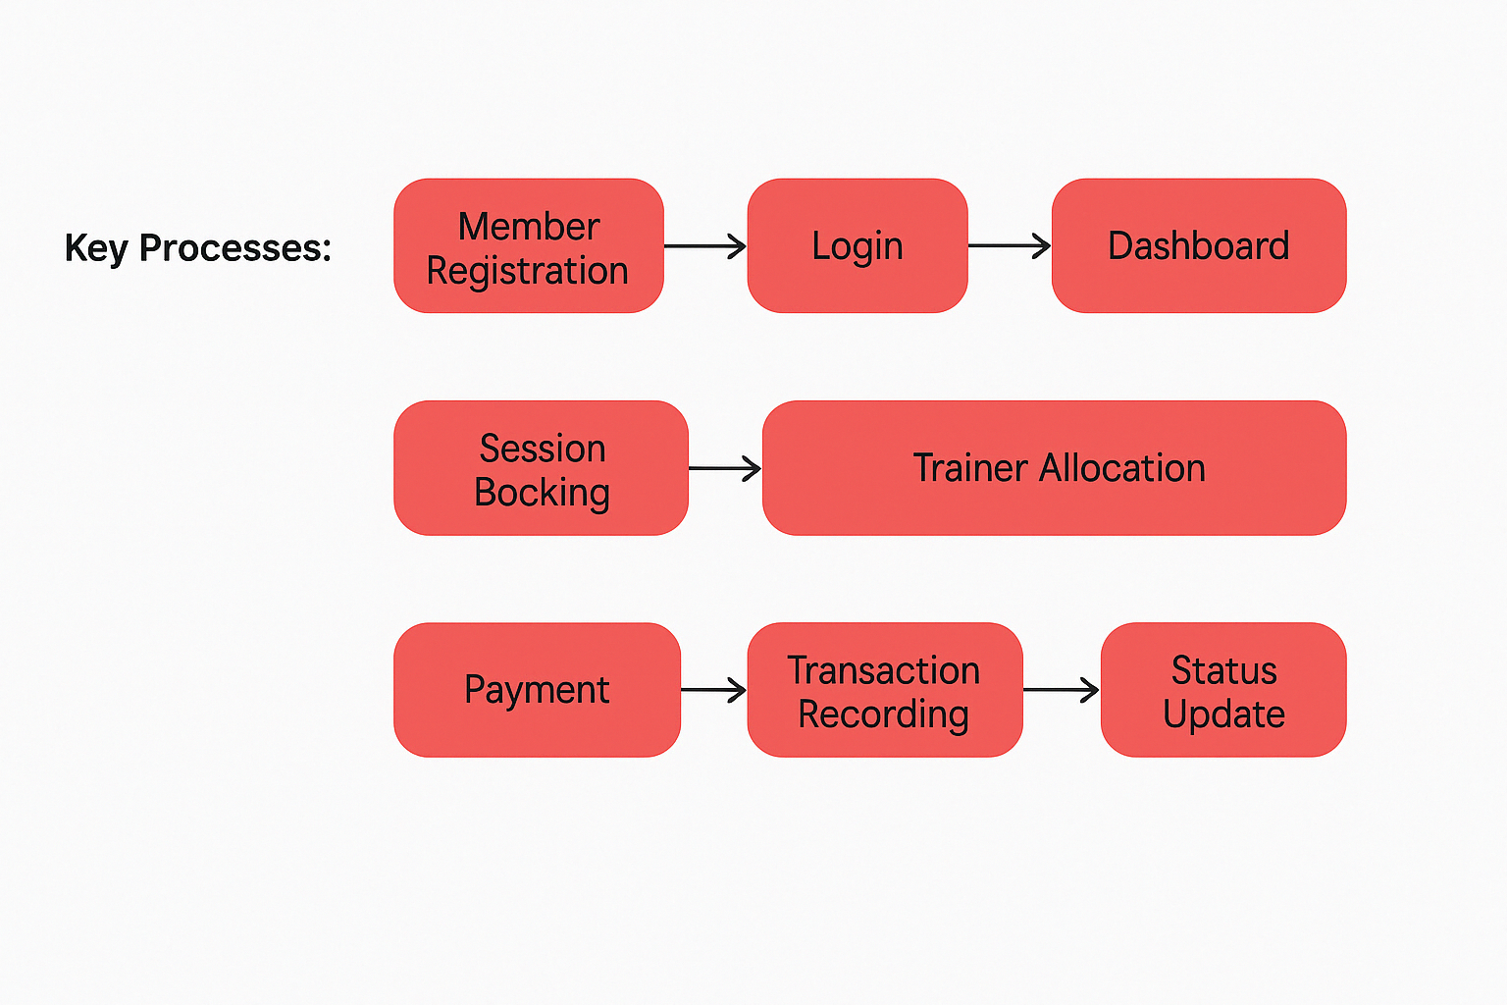
PROJECT FLOW

Slide 11
OBJECTIVE & SCOPE OF THE PROJECT
Objectives | Scope
Scope | Single gym implementation
Digitize payment records | Basic reporting
Streamline session scheduling | 5 core modules ( members, trainers etc.)
Ensure data integrity | Desktop/web access
Department of CSE (Data Science), DSCE

Slide 12
HARDWARE & SOFTWARE REQUIREMENT
HARDWARE REQUIREMENTS | SOFTWARE REQUIREMENTS
CPU: Intel i3+ (4 cores) | Oracle Database XE 21c
RAM: Minimum 8GB (16GB recommended ) | Python 3.9 + Flask + cx_Oracle
OS: Windows 10+/Linux | SQL Developer , Code
Storage: 10GB (for Oracle) | Web Browser (Chrome/Firefox)
Department of CSE (Data Science), DSCE

Slide 13
REFERENCES
Chopra, Rajiv. Database Management System (DBMS) A Practical Approach. S. Chand Publishing, 2010.
Post, Gerald V. Database management systems. PHI Learning Pvt. Limited, 2009.
Narang, Rajesh. Database management systems. PHI Learning Pvt. Ltd., 2018.
Python Flask - https://flask.palletsprojects.com/en/stable/
HTML,CSS - https://developer.mozilla.org/en-US/docs/Web/HTML/Reference/Elements
JavaScript - https://developer.mozilla.org/en-US/docs/Web/JavaScript
ORACLE XE - https://www.oracle.com/in/database/technologies/appdev/xe.html
Department of CSE (Data Science), DSCE

Slide 14
THANK YOU
Department of CSE (Data Science), DSCE

